Slide 1
Handwriting Analysis

Slide 2
HANDWRITING ANALYSIS
Forensic analysts use handwriting analysis in the event that a handwritten note is left behind (purposefully or accidentally) at a crime scene

Slide 3
HANDWRITING ANALYSIS
Forensic analysts use handwriting analysis in the event that a handwritten note is left behind (purposefully or accidentally) at a crime scene
Analysts looks at every last detail to match the writing to a suspect
  Letter formation, size, slope, pen pressure, pen lifts

Slide 4
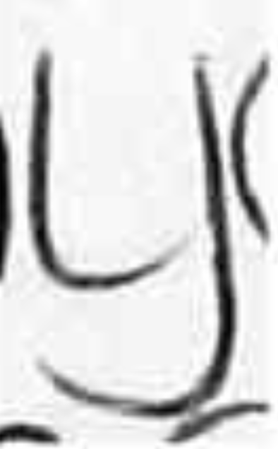
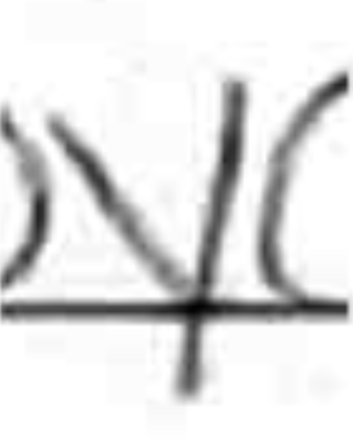
HANDWRITING ANALYSIS
Forensic analysts use handwriting analysis in the event that a handwritten note is left behind (purposefully or accidentally) at a crime scene
Analysts looks at every last detail to match the writing to a suspect
  Letter formation, size, slope, pen pressure, pen lifts
What makes these letters distinct?
Example 1
vs.

Slide 5
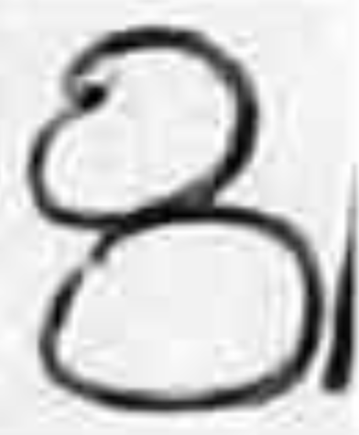
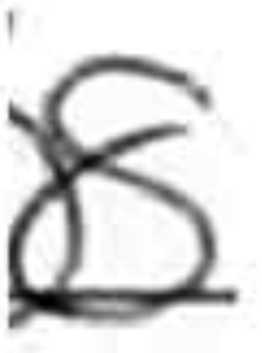
HANDWRITING ANALYSIS
Forensic analysts use handwriting analysis in the event that a handwritten note is left behind (purposefully or accidentally) at a crime scene
Analysts looks at every last detail to match the writing to a suspect
  Letter formation, size, slope, pen pressure, pen lifts
What makes these numbers distinct?
Example 2
vs.

Slide 6
HANDWRITING CHARACTERISTICS
Size: height and width of letters and words
Spacing: space between letters and words
Slope: letters and words are straight or slanted either left or right
Pressure: writing is light, implying little pressure was used, or vice versa
Capitalization: capitalization is used appropriately or not
Punctuation: punctuation is used appropriately or not
Embellishments: letters incorporate fancy symbols or pictures

